Slide 1

Quest 1:
Negar Mokhtari

Slide 2

Project overview:
Challenge:
create a text based Escape Room in Python, where the user moves from the Games room through other rooms to ultimately escape the house.
Game’s structure:
define a function called “escape room” using iterations.
There are 4 rooms each contains doors, keys and household items.
If user find the correct key then can go to the other room.
User should examine household items in order to find the correct key to the door.
If user doesn’t have the right key then the door remains locked.

Slide 3
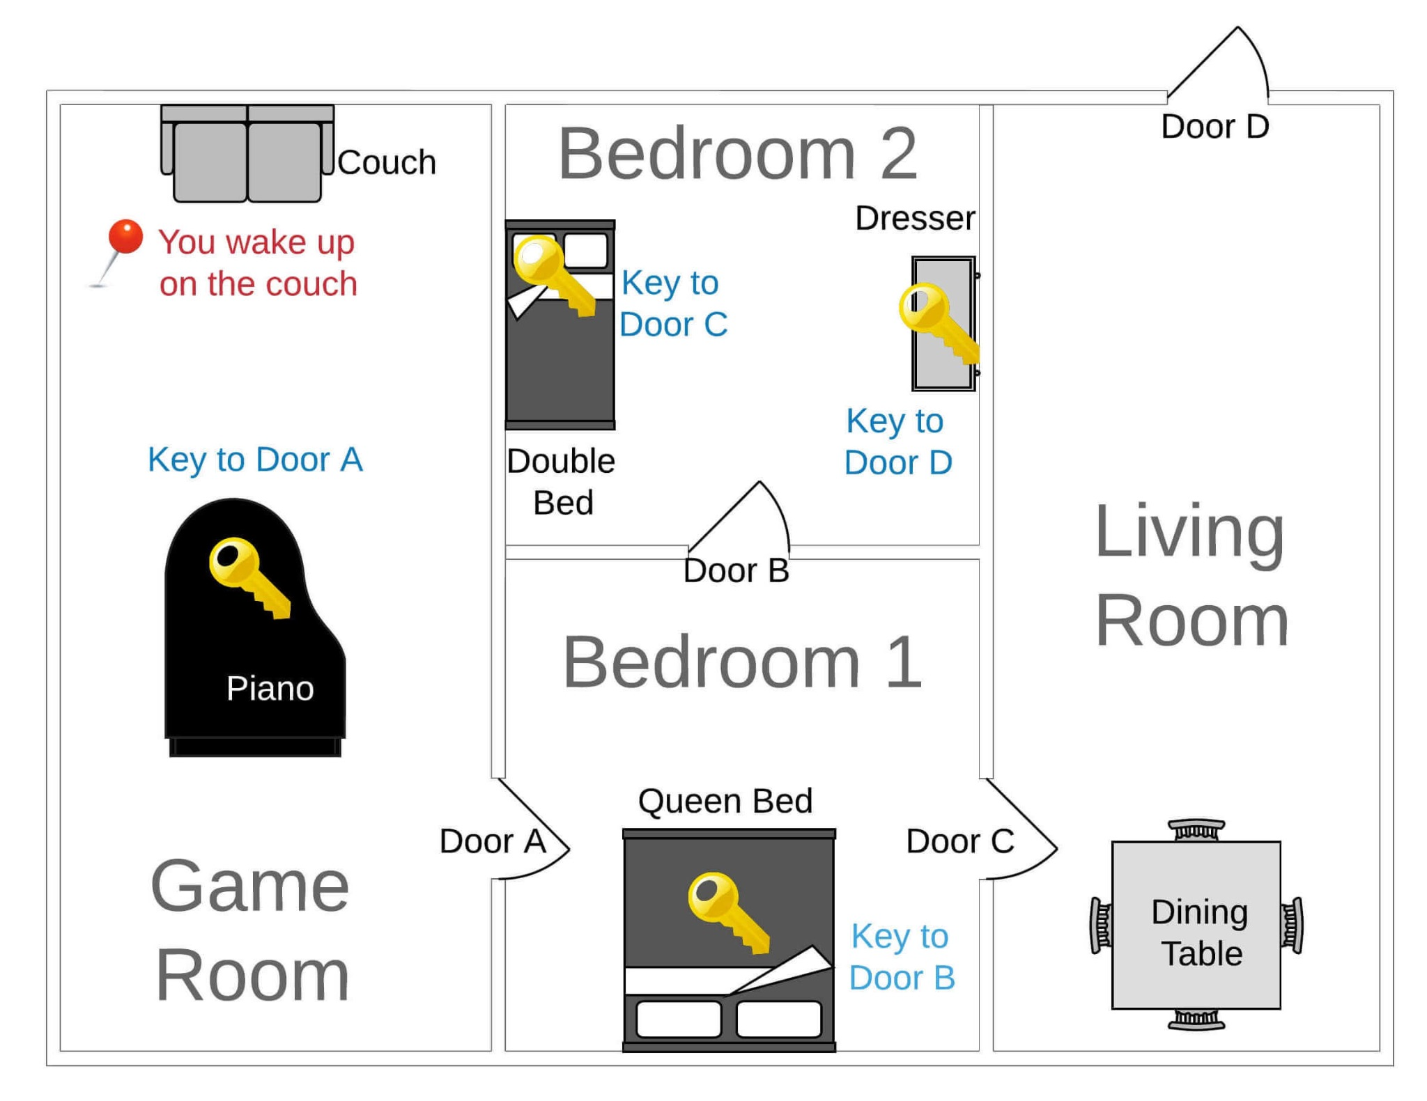
Rooms map:

Slide 4

Technical challenges
Time constraints
Built two versions of the game:
1st version: detailed and only covers one room
2nd version: simpler but user is able to escape
Big mistake
Initially trying to tackle each room independently instead of building a loop which allows the user to explore and make choices based on the list of rooms.
Initial code very detailed and prone to errors, which were hard to handle .

Slide 5
Demo project
link to demo on google drive

Slide 6
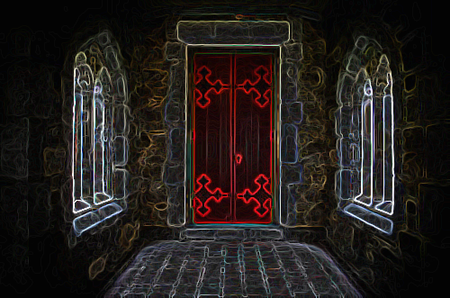
Thank you
ESCAPE ROOM:

